Slide 1
HOSPITAL MANAGEMENT SYSTEM
-SHREYA GUPTA Guided by – YOGANAND S.

Slide 2
Abstract
The Hospital Management System (HMS) is a web-based platform designed to simplify hospital operations by allowing patients to book appointments, register, and contact the hospital online. It provides a structured and efficient way to manage patient records while reducing administrative workload. Additionally, the system includes a basic Skin Disease Predictor that gives an initial assessment before seeking professional consultation. This project aims to enhance accessibility, organization, and efficiency in healthcare services through a user-friendly digital solution.

Slide 3
Problem Statement
Hospitals often struggle with managing patient records, scheduling appointments, and handling communication efficiently when relying on manual processes. Patients may face delays in booking consultations, while hospital staff may find it difficult to keep track of information accurately. Additionally, identifying skin diseases at an early stage can be challenging without specialized medical knowledge. To address these issues, there is a need for a digital system that simplifies hospital operations, improves patient accessibility, and offers basic AI-powered assistance for preliminary skin disease detection.

Slide 4
Existing System
In many hospitals, management processes are still handled manually or with outdated software, leading to several inefficiencies:
Manual Record-Keeping – Patient records are often maintained on paper, increasing the risk of misplacement or errors.
Appointment Scheduling Delays – Patients must visit the hospital physically to book or modify appointments, causing inconvenience.
Inefficient Communication – Lack of a proper communication system makes it difficult for patients to reach hospital staff easily.
Time-Consuming Processes – Managing hospital administration manually can lead to slow service and increased workload for staff.
Lack of Preliminary Diagnosis – There is no quick way for patients to get an initial assessment of skin conditions, requiring them to wait for specialized consultations.
Need for Digitalization – A structured and digital approach is necessary to improve hospital efficiency and patient accessibility.

Slide 5
Proposed System
To overcome the inefficiencies of manual hospital management, we propose a web-based Hospital Management System (HMS) that streamlines hospital operations and enhances patient accessibility. This system will provide:
Online Appointment Booking – Patients can book, modify, or cancel appointments without visiting the hospital.
User Registration & Login – Secure authentication for patients and hospital staff to manage their respective data.
Contact & Communication System – A dedicated section for patients to reach out to the hospital for inquiries.
Patient Record Management – Digital storage of patient details for quick and efficient retrieval by hospital staff.
Skin Disease Predictor – A basic tool that offers preliminary insights into skin conditions before professional consultation.
By implementing this system, hospitals can reduce paperwork, minimize errors, and improve efficiency, while patients can access services conveniently from anywhere. This digital approach ensures a faster, more organized, and accessible healthcare experience for all users.

Slide 6
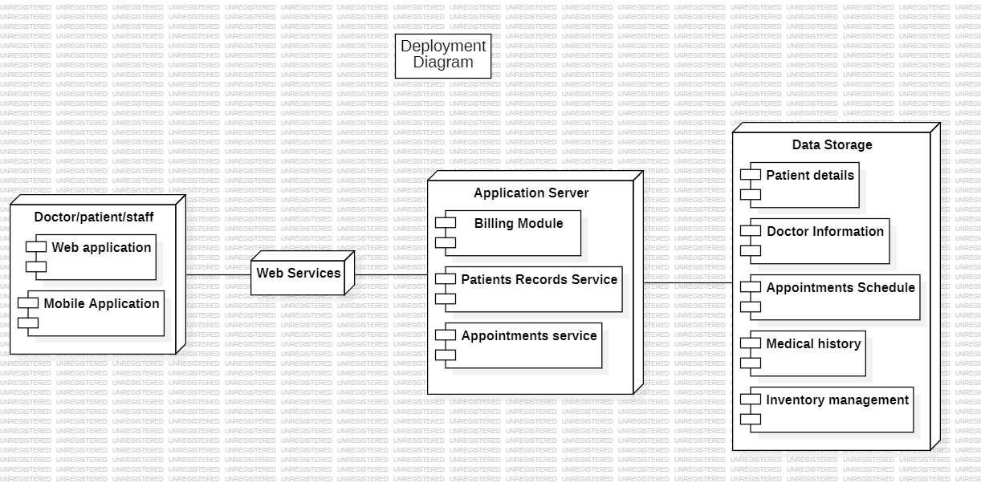
Overall Architecture

Slide 7
Functional Requirement
Actors-
Primary Actor:
-Patient:
Books appointments with doctors.
Views their appointment history.
Contacts the hospital for inquiries.
Supporting Actor:
-System
Handles authentication and security.
Stores and retrieves patient and appointment data.
Sends notifications for appointment confirmations or reminders.

Slide 8
Functional Requirement
2. Actions-
Book Appointment:
Patients select a doctor and available time slot.
System verifies availability and confirms the booking.
View Appointments:
Patients view their upcoming and past appointments.
Doctors check their scheduled appointments for the day.
Manage Patient Records:
Doctors update patient medical history and prescriptions.
Admins maintain records for hospital management.
Cancel or Reschedule Appointment:
Patients can request cancellations or changes.
System notifies doctors and updates availability.
Send Notifications:
System sends appointment reminders to patients via email/SMS.
Alerts for appointment confirmations, cancellations, or follow-ups.
Login & Authentication:
Patients, doctors, and admins log in using secure credentials.
System ensures role-based access to relevant data.

Slide 9
Functional Requirement
3. Object-
Patient Data:
Name: Full name of the patient.
Age: Patient's age (numeric).
Medical History: Past and current medical conditions.
Contact Information: Phone number and email for communication.
Appointment Data:
Patient Name: Name of the person booking the appointment.
Doctor Assigned: Name of the doctor assigned.
Date & Time: When the appointment is scheduled.

Slide 10
Functional Requirement
4. Qualifier-
Validation Rules:
Patient name must only contain alphabetic characters.
Age must be a numeric value and greater than 0.
Appointment date must be in YYYY-MM-DD format.
Contact information must be a valid phone number or email.
Doctors can only be assigned appointments during their availability.
Error Handling:
If incorrect login credentials are entered, display "Invalid Username or Password."
If an appointment slot is unavailable, show "Selected time is already booked. Please choose another slot."
Ensure that all required fields are filled; otherwise, display "Please complete all fields before submitting."

Slide 11
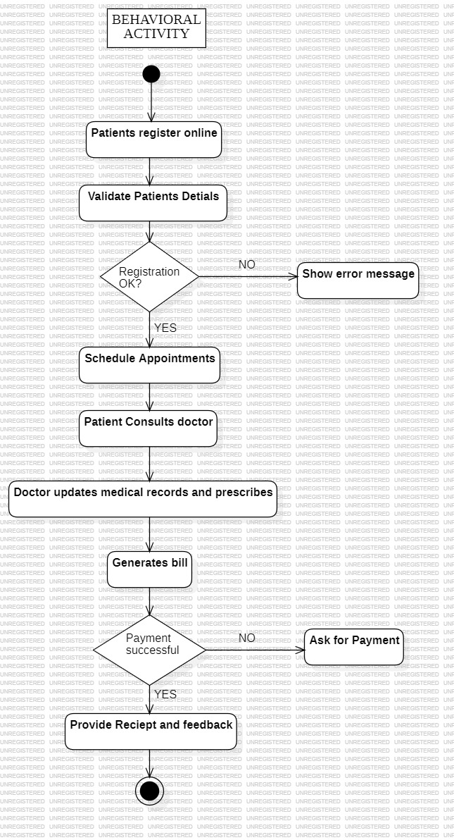
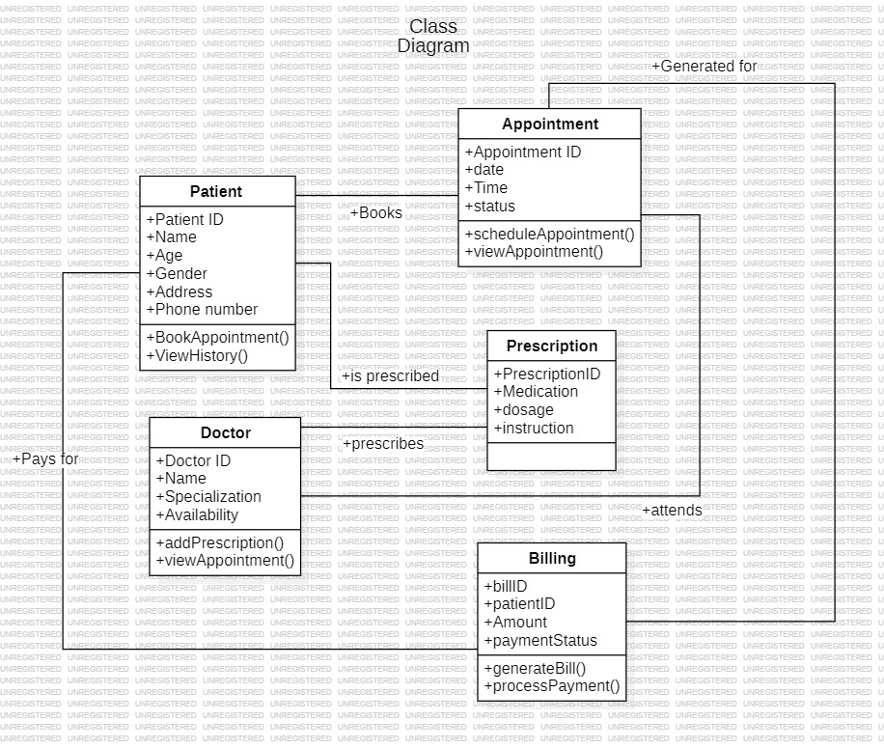
Design Diagrams

Slide 12
Design Diagrams

Slide 13
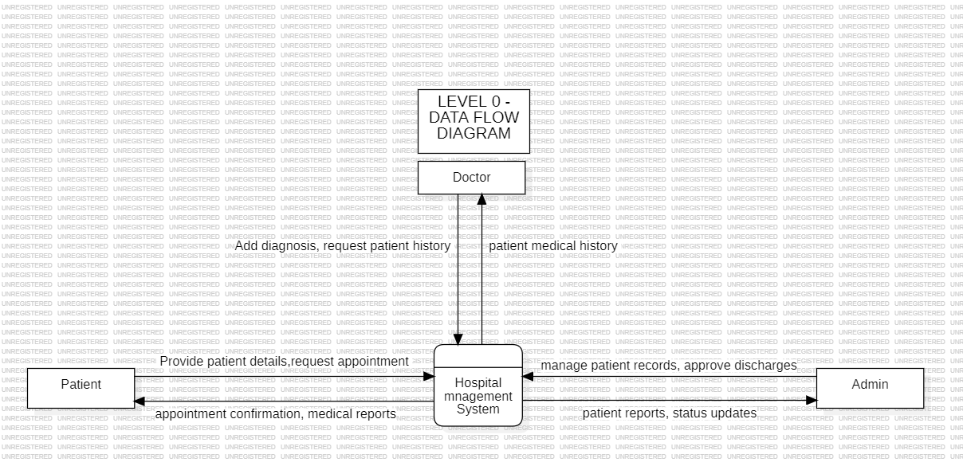
Design Diagrams

Slide 14
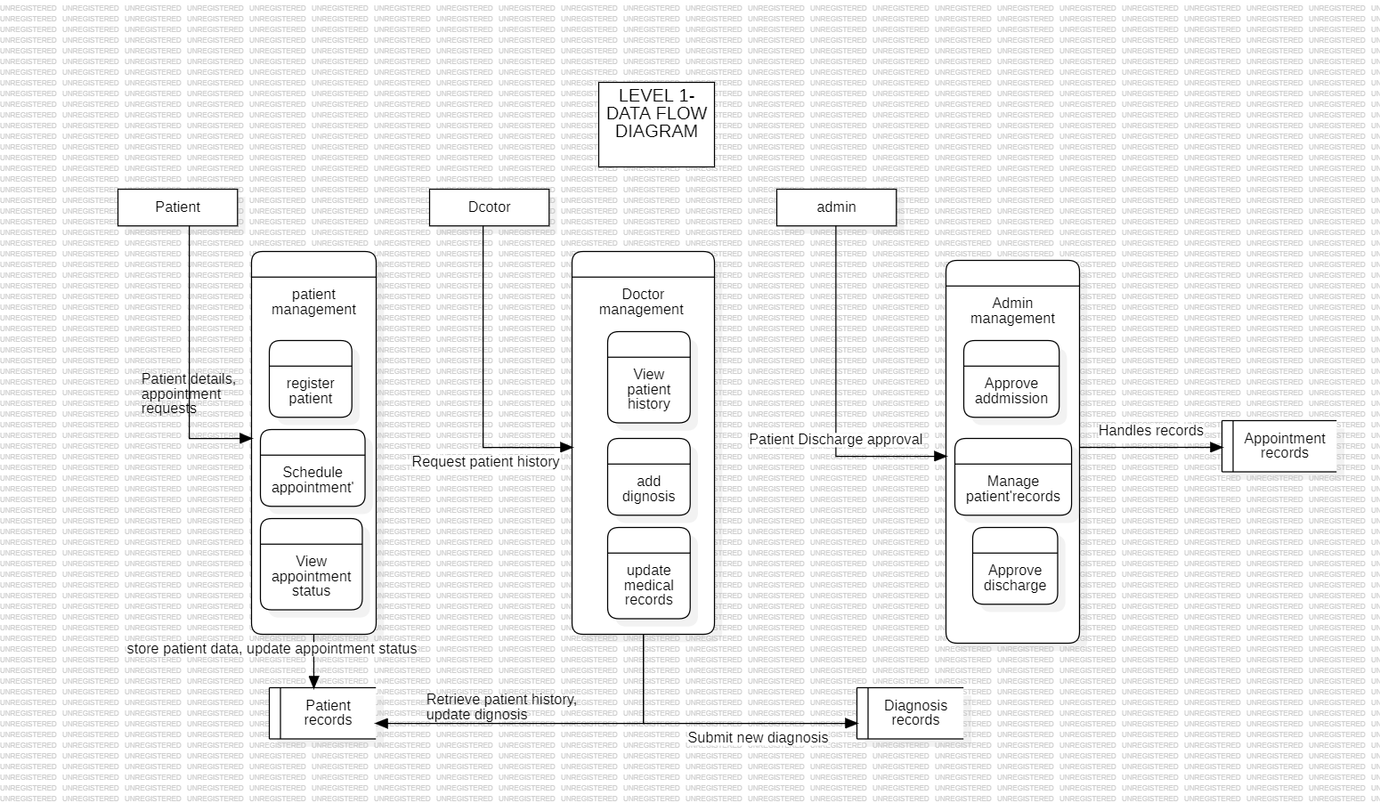
Design Diagrams

Slide 15
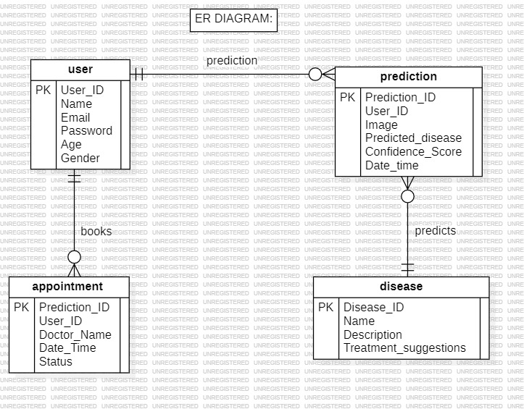
Design Diagrams

Slide 16
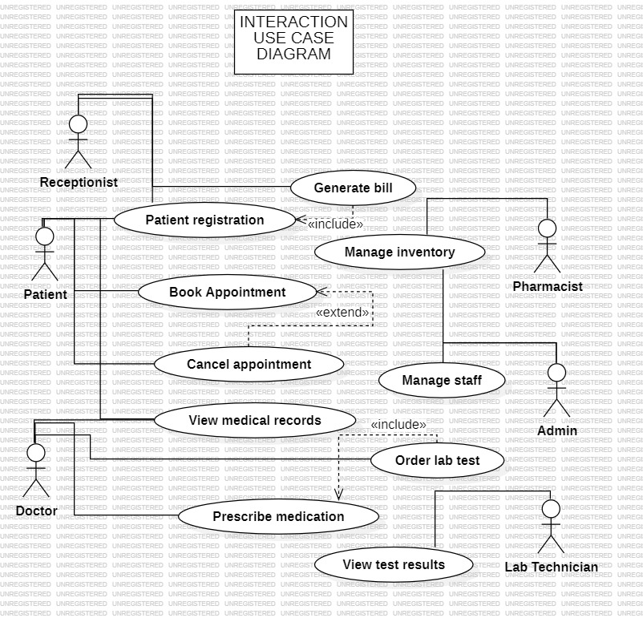
Design Diagrams

Slide 17
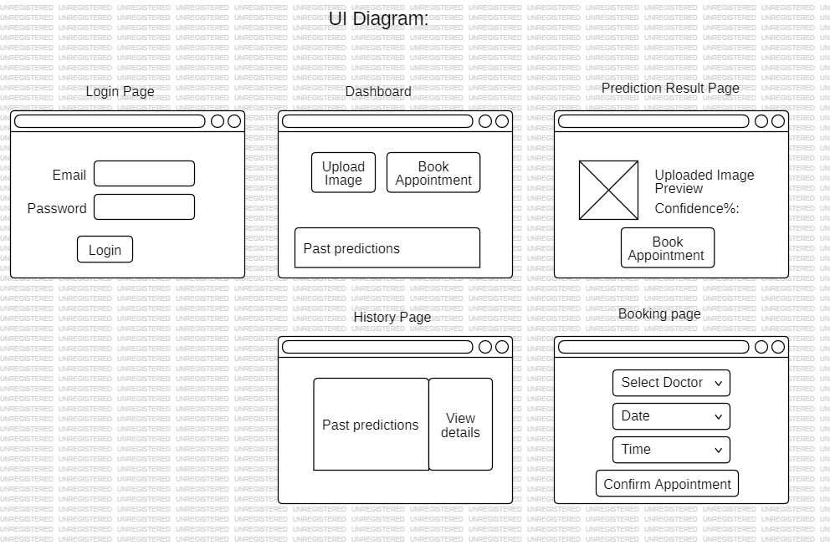
Design Diagrams

Slide 18
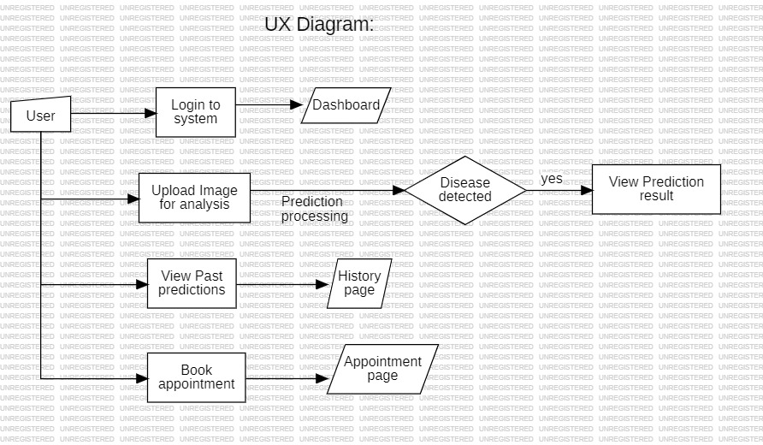
Design Diagrams

Slide 19
Sample code
https://github.com/shreya320/HMS

Slide 20
Sample Test Case
# Function to test navigation
def test_navigation(link_text, expected_url):
try:
link = driver.find_element(By.LINK_TEXT, link_text) # Find link by text
link.click()
time.sleep(2) # Wait for page to load
# Check if URL contains expected file name
if expected_url in driver.current_url:
print(f"✅ {link_text} navigation test passed!")
else:
print(f"❌ {link_text} navigation test failed. Expected {expected_url}, but got {driver.current_url}")
except Exception as e:
print(f"⚠️ Error testing {link_text}: {e}")
for link_text, expected_url in nav_links.items():
test_navigation(link_text, expected_url)
# Close the browser
driver.quit()
}
This test ensures that the navigation links, such as "HOME" and "CONTACT US," redirect users to the correct pages when clicked, confirming that the site's navigation functions as expected.
from selenium import webdriver
from selenium.webdriver.chrome.service import Service
from webdriver_manager.chrome import ChromeDriverManager
from selenium.webdriver.common.by import By
import time
service = Service(ChromeDriverManager().install())
driver = webdriver.Chrome(service=service)
driver.get("file:///C:/Users/shrey/OneDrive/Desktop/skin%20detection/index.html")
nav_links = {
"HOME": "index.html",
"CONTACT US": "contact.html",
"ABOUT US": "about.html",
"DOCTORS": "doctors.html",
"REGISTRATION": "registration.html",
"LOGIN": "login.html",
"BOOK APPOINTMENT": "appointment.html"
}

Slide 21
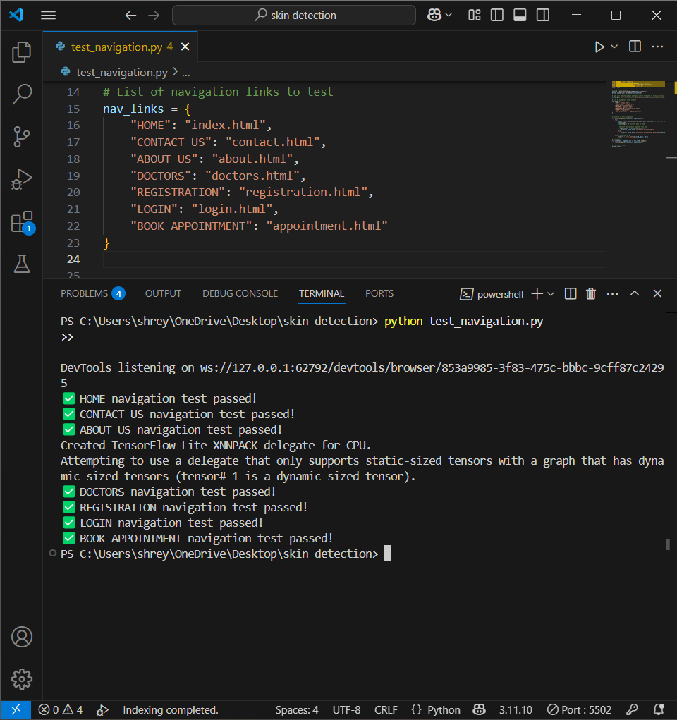
Sample Test Case

Slide 22
Testing tools used
Selenium (End-to-End Testing) – Automates UI interactions, testing form submissions, navigation, and user flows.

Slide 23
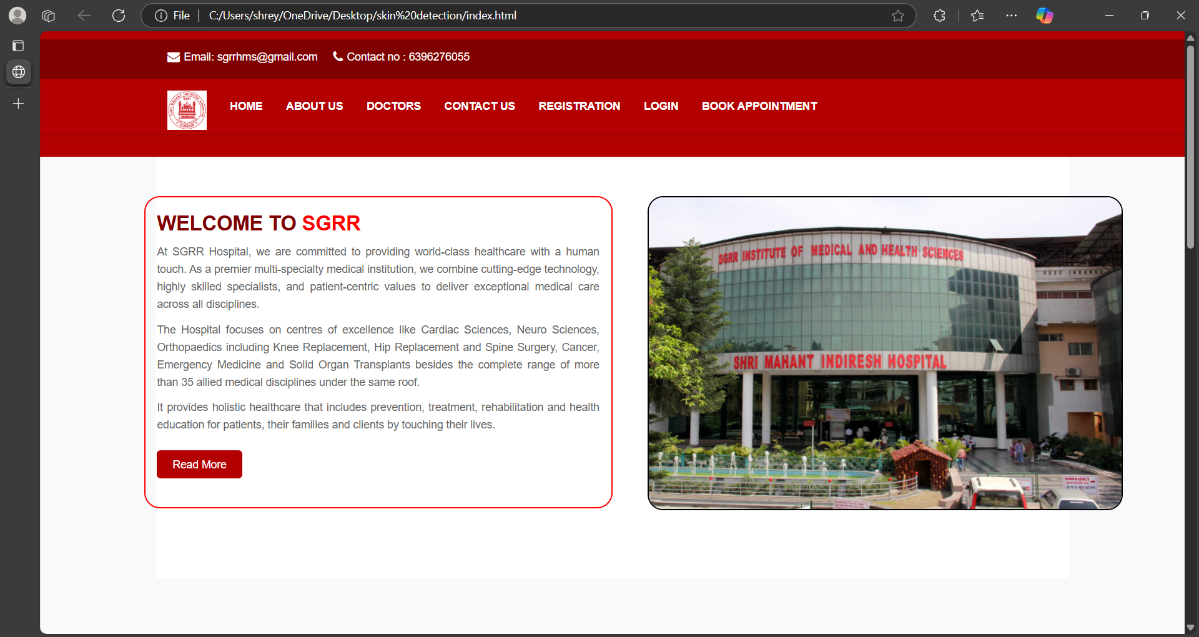
Output Screenshots

Slide 24
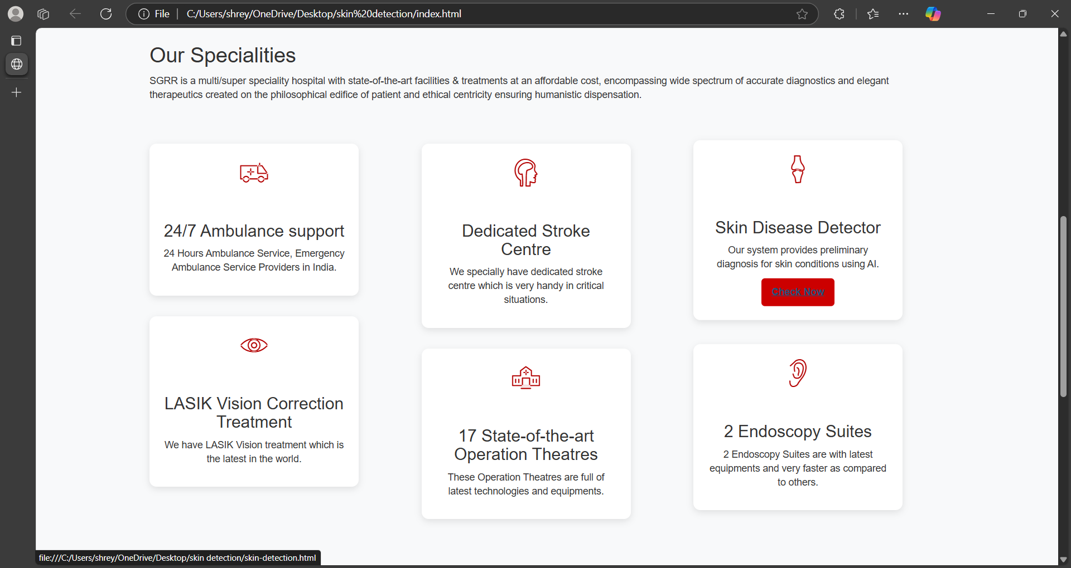
Output Screenshots

Slide 25
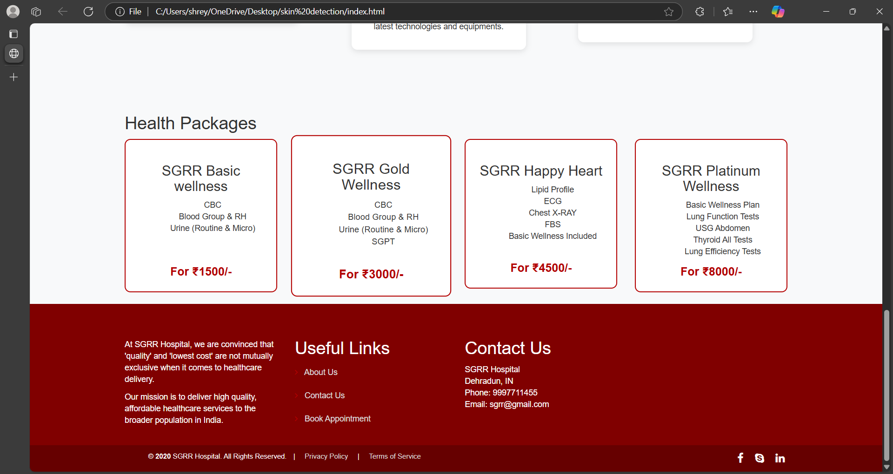
Output Screenshots

Slide 26
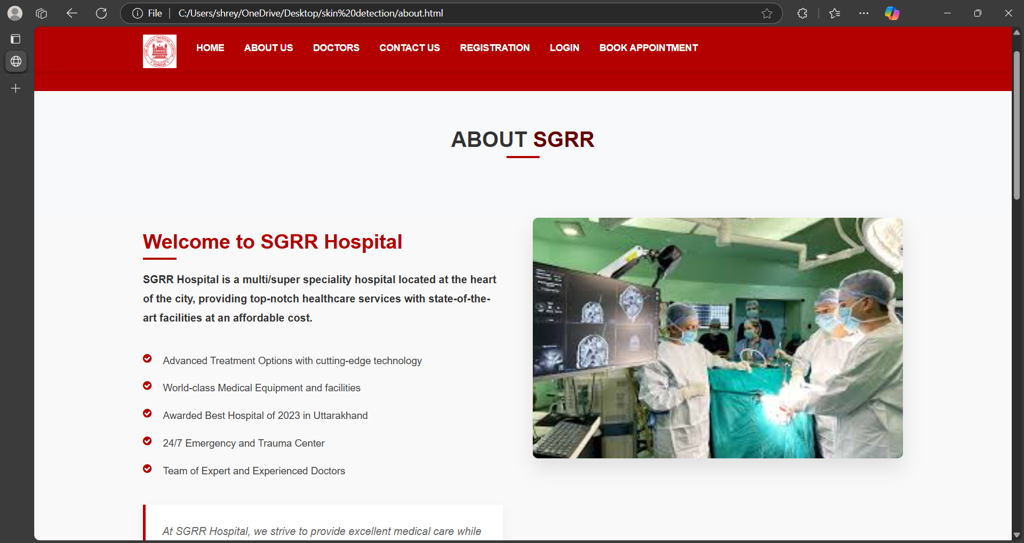
Output Screenshots

Slide 27
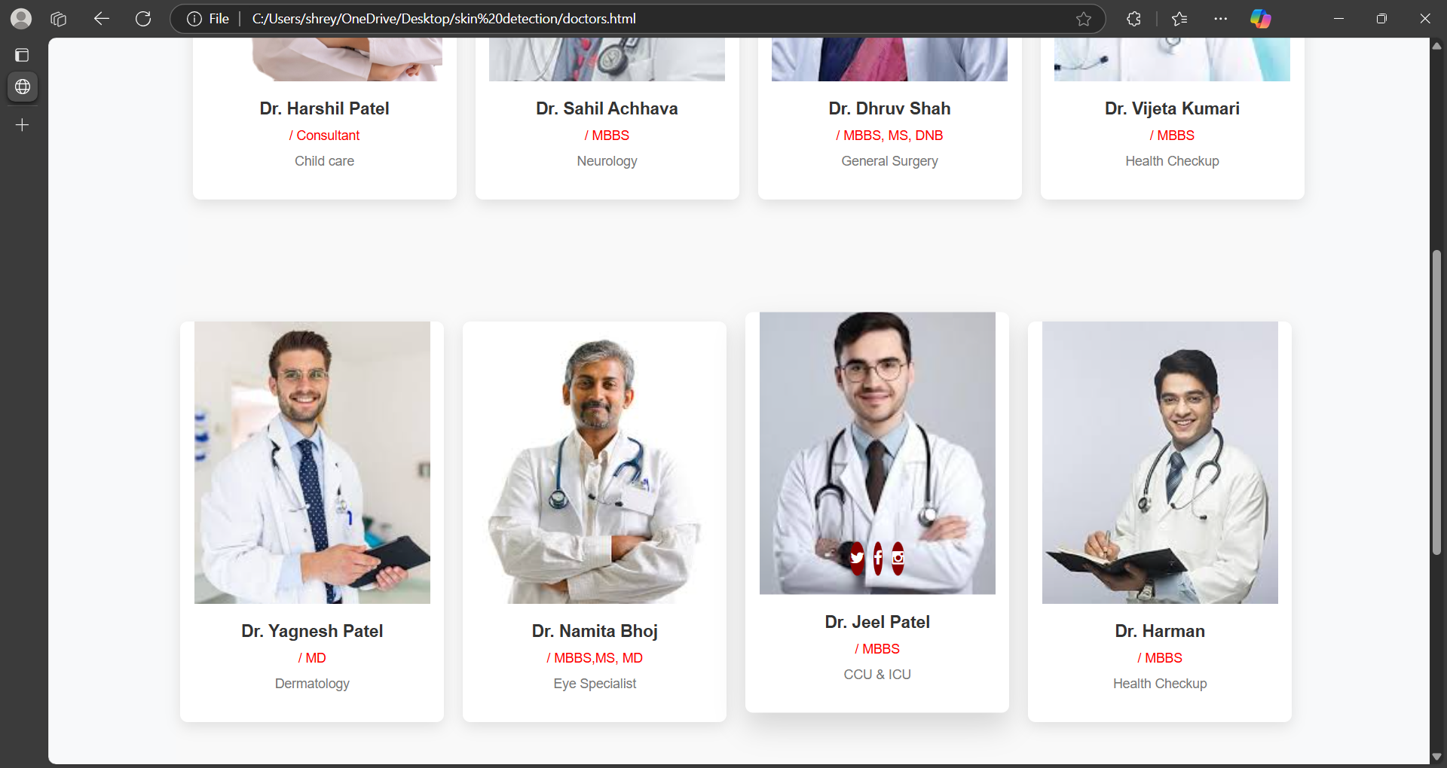
Output Screenshots

Slide 28
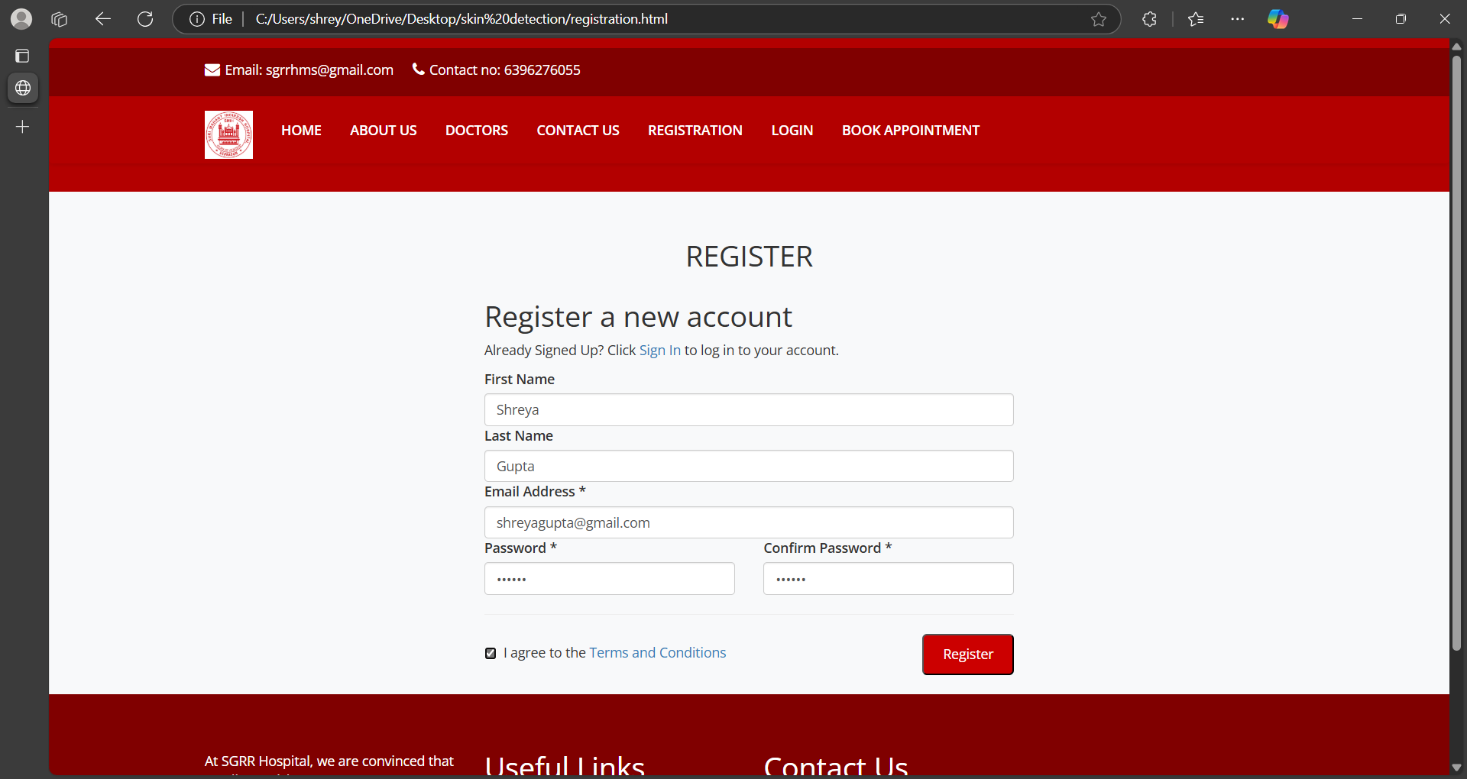
Output Screenshots

Slide 29
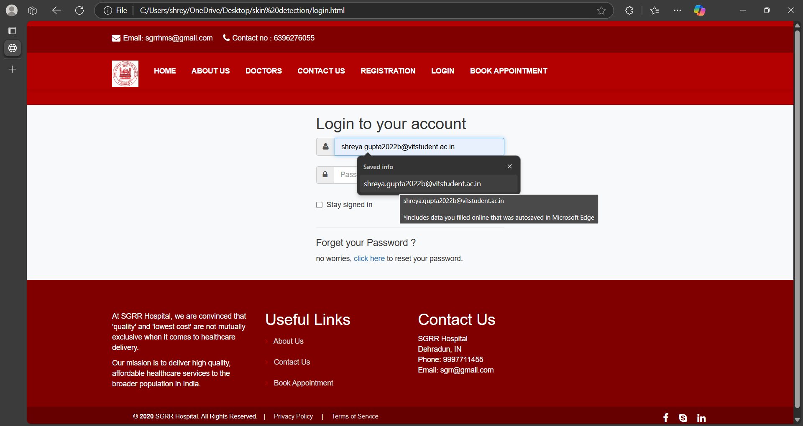
Output Screenshots

Slide 30
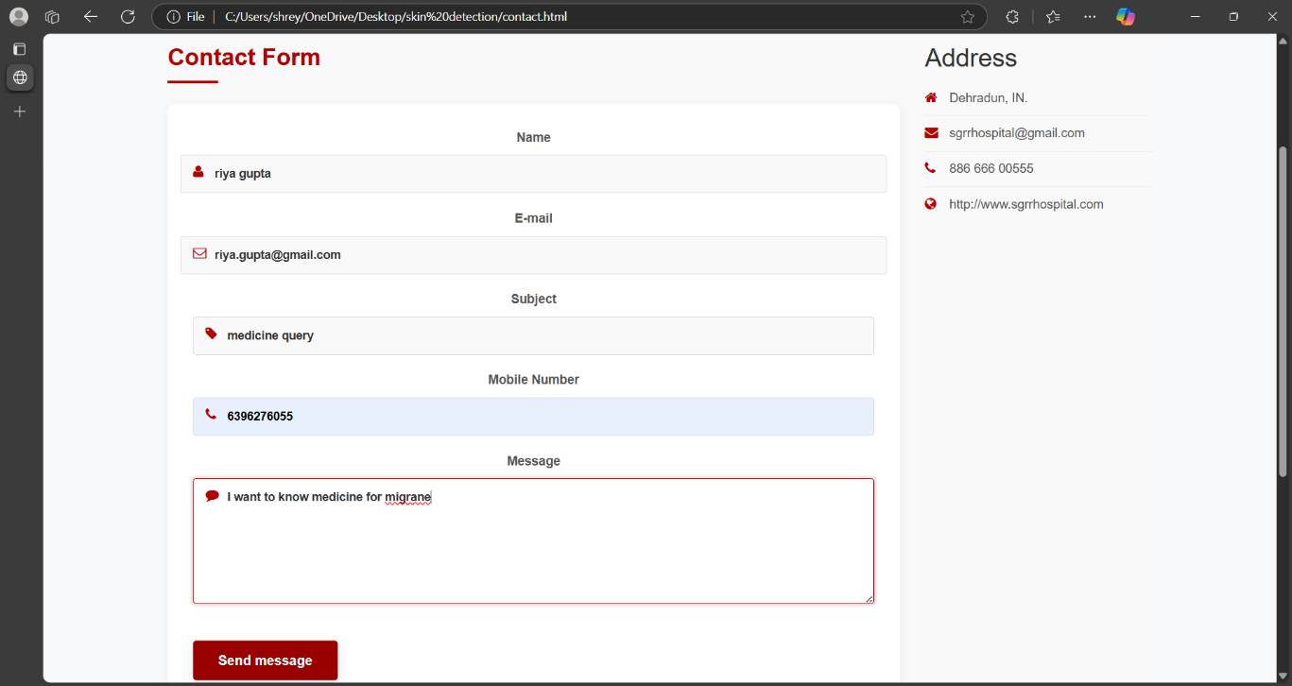
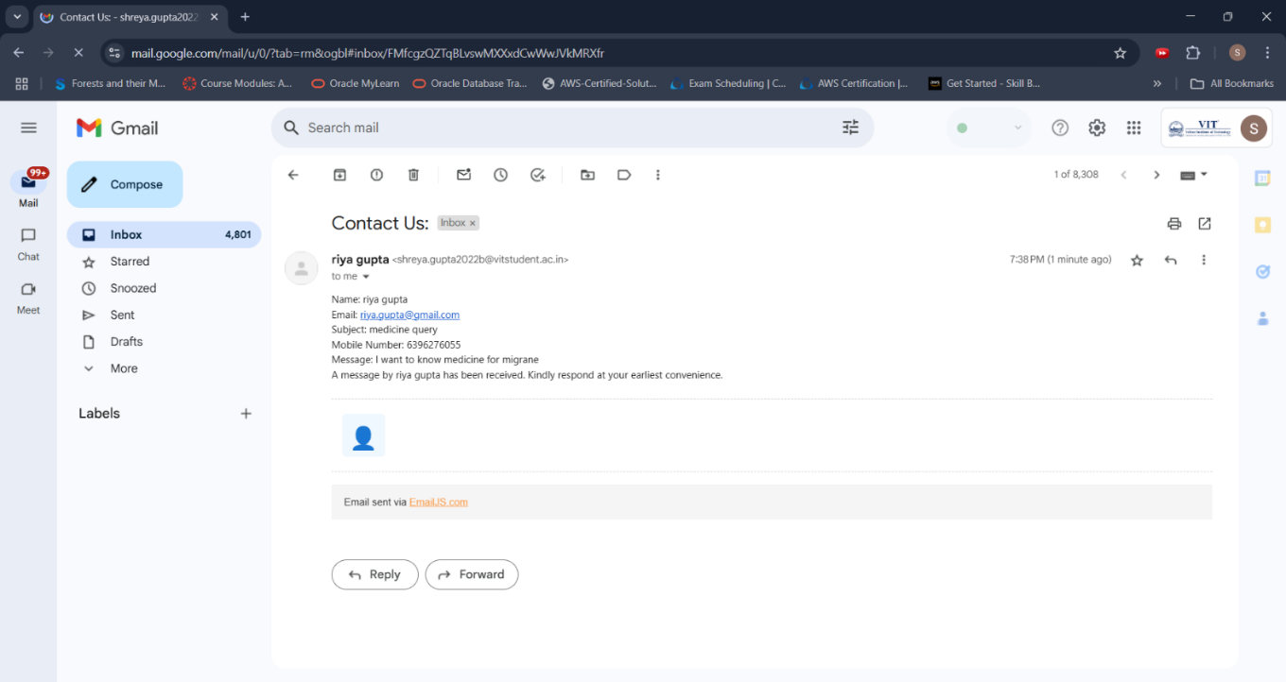
Output Screenshots

Slide 31
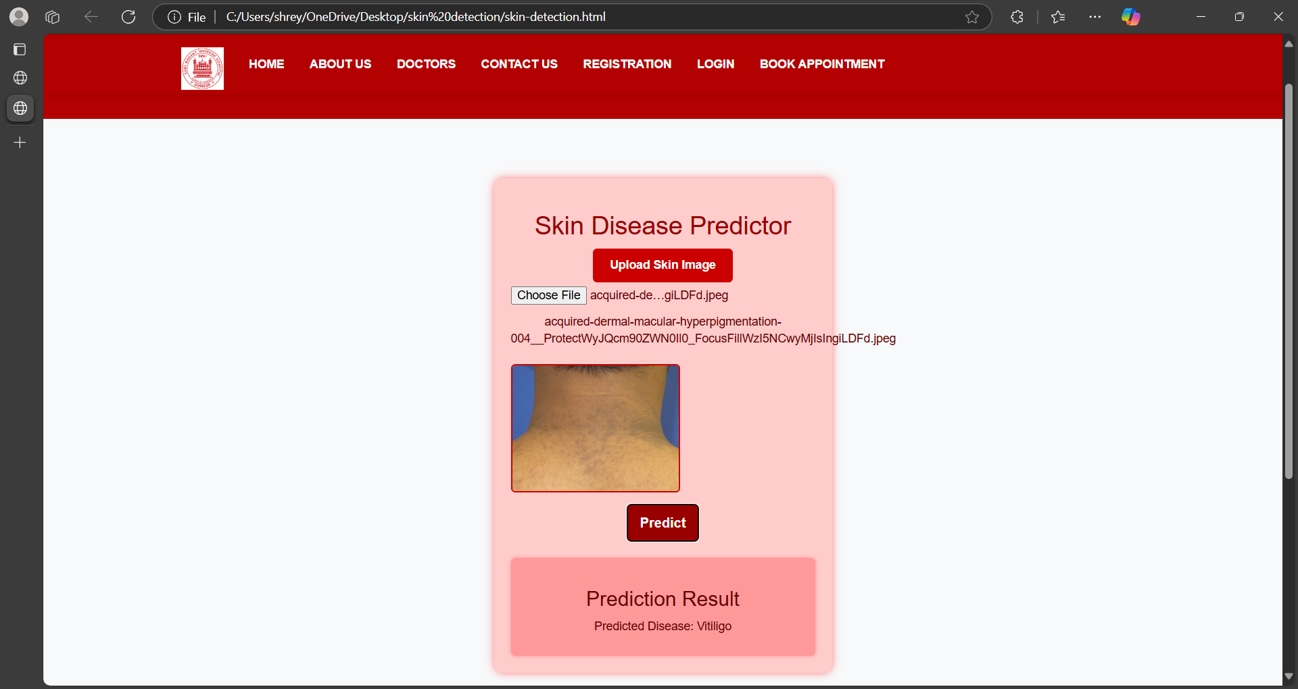
Output Screenshots

Slide 32
conclusion
The Hospital Management System (HMS) is designed to streamline hospital operations by managing patient records, doctor appointments, and essential administrative tasks efficiently. By integrating MySQL for data management, the system ensures secure and structured storage of patient and hospital-related information. The intuitive user interface, developed using HTML, CSS, and JavaScript, provides ease of access and navigation for both patients and hospital staff.
This system not only enhances appointment scheduling and patient record management but also improves overall hospital efficiency by reducing manual workload and minimizing errors. Future enhancements could include mobile compatibility, automated reminders, and integration with medical devices to further improve patient care and hospital services.
With its user-friendly approach and essential healthcare functionalities, the HMS serves as a reliable solution
for modern healthcare institutions, ensuring a seamless and organized workflow.

Slide 33
References
1. https://data.mendeley.com/datasets/3hckgznc67/1
2. https://www.sgrru.ac.in/
3. https://www.lucidchart.com
4. https://staruml.io/download/
5. https://www.python.org/downloads/release/python-3110/
6. https://www.emailjs.com/
7. https://getbootstrap.com/
8 https://fontawesome.com/
9. https://fonts.google.com/
10. https://www.adroitinfosystems.com/products/ehospital-systems/

